Slide 1
PRESENTATION
ABOUT Start up

Slide 2

LOGO

Slide 3
Shares Era
Here we provide the Share market details about the different companies which we have collaborated with. With this app the customers or users will easily know about the present market share value where they invested their money. We will display the company details and reputation of the companies and the previous share value ratings etc…. We are not only provide the share market or share value details, we will also teach about the investment strategies and the customers who even don’t know about the share market and also we will teach the business strategies to the persons who wants to start a business without any knowledge.

Slide 4
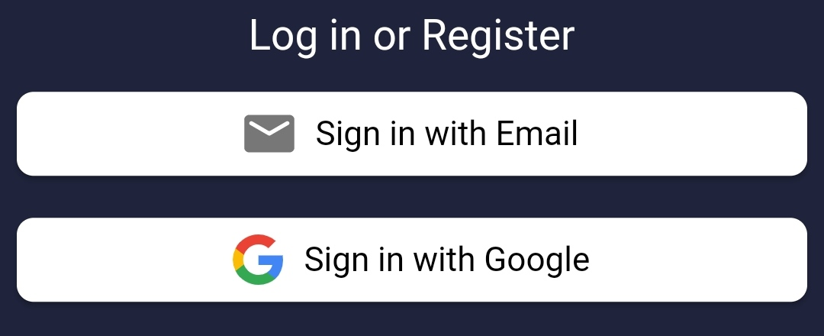
APP CONTENTS

Slide 5
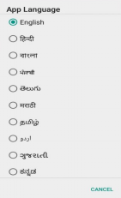
Languages

Slide 6

AMAZON
FLIPKART
PEPSI CO
PWC
ANDERSON

Slide 7
Company Details
About the Company:
Amazon was founded by Jeff Bezos from his garage in Bellevue, Washington,on July 5, 1994. Initially an online marketplace for books, it has expanded into a multitude of product categories, a strategy that has earned it the moniker The Everything Store. It has multiple subsidiaries including Amazon Web Services (cloud computing), Zoox (autonomous vehicles), Kuiper Systems (satellite Internet), and Amazon Lab126 (computer hardware R&D). Its other subsidiaries include Ring, Twitch, IMDb, and Whole Foods Market. Its acquisition of Whole Foods in August 2017 for US$13.4 billion substantially increased its footprint as a physical retailer.
Amazon has earned a reputation as a disruptor of well-established industries through technological innovation and "aggressive" reinvestment of profits into capital expenditures.[10][11][12][13] As of 2023, it is the world's largest online retailer and marketplace, smart speaker provider, cloud computing service through AWS, live-streaming service through Twitch, and Internet company as measured by revenue and market share. In 2021, it surpassed Walmart as the world's largest retailer outside of China, driven in large part by its paid subscription plan.

Slide 8
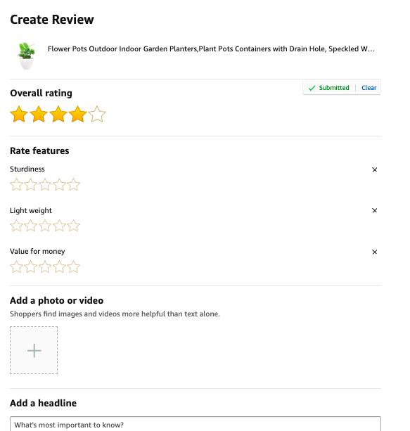
Previous Share market Ratings & Reviews

Slide 9
Present Sensex Updates

Slide 10
______
______
______
INFORMATION
SHARE MARKET DETAILS
START-UP STUFF
STRATEGIES
INVESTMENT THINGS
START-UP IDEAS
START-UP STRATEGIES
CAPITAL

Slide 11
Source From
https://en.wikipedia.org/wiki/Amazon_(company)
https://www.wsj.com/market-data/quotes/AMZN/research-ratings
https://www.wsj.com/market-data/quotes/AMZN/research-ratings

